Slide 1

Rockbuster Market Analysis
Thalia Giraldo

Slide 2



Motivation
Building a stronger brand in key markets

Slide 3
Key Questions
Where are Rockbuster’s customers located?
What is the behavior of a typical customer?
What are the top countries and cities based on customers and spend?
What are the behaviors of a top spending customer?
What insights can we draw to improve branding strategies?

Slide 4
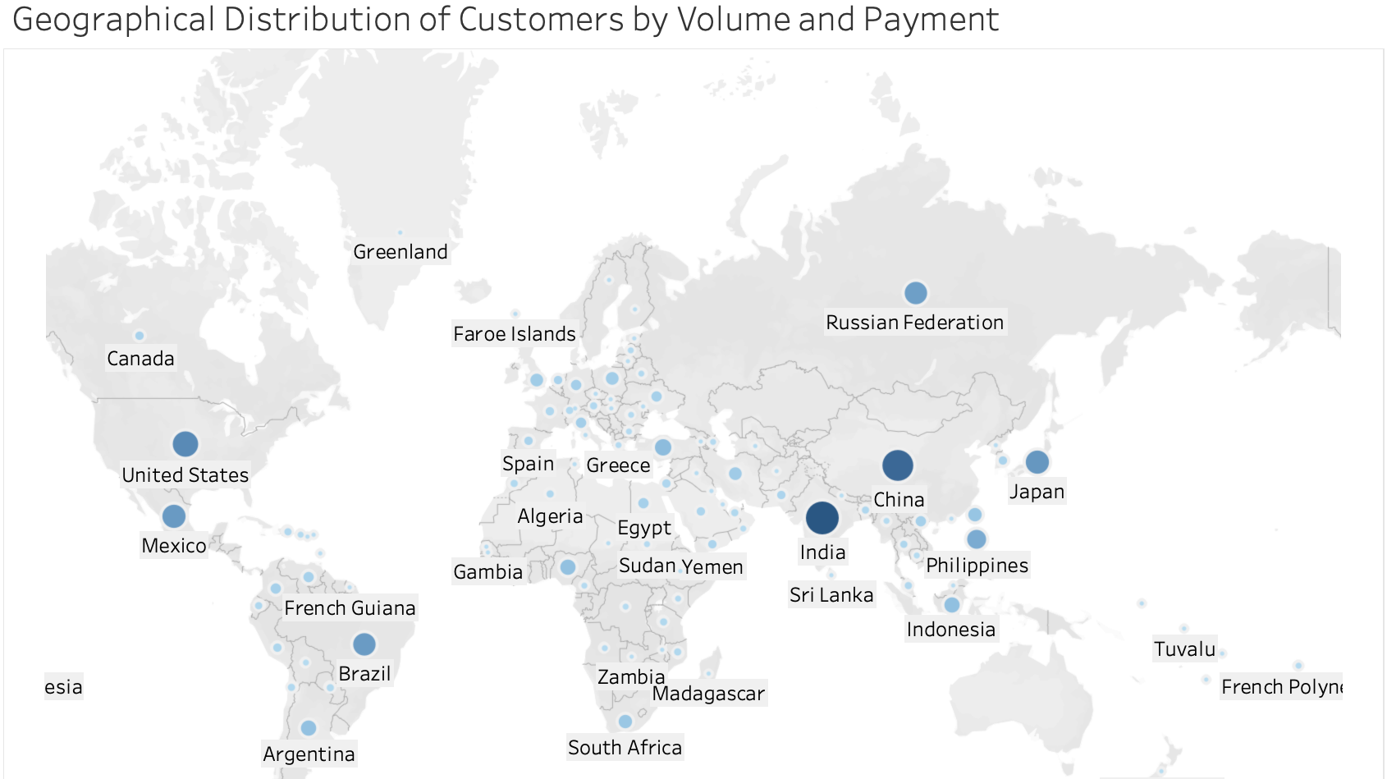
Notes:
1. Customers and Spend Query

Slide 5
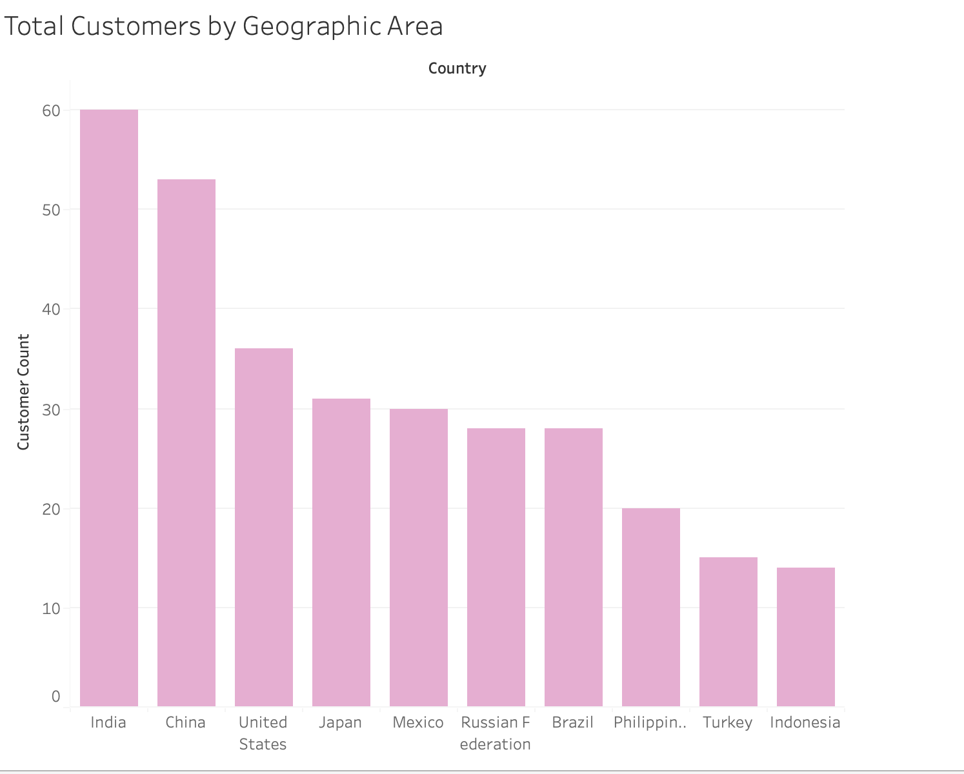
Key MARKETS By COUNTRY and Customer volume
India, China, United States, Japan and Mexico make up the top 5 countries where customers are located
India has the most customers at 60
Notes:
Customers and Spend Query

Slide 6

Average customer spending
Maximum Amount | Minimum Amount | Average Amount
$11.99 | $0.99 | $4.20

Slide 7
Average customer rental duration
Maximum Duration | Minimum Duration | Average Duration
7 | 3 | 4.9

Slide 8
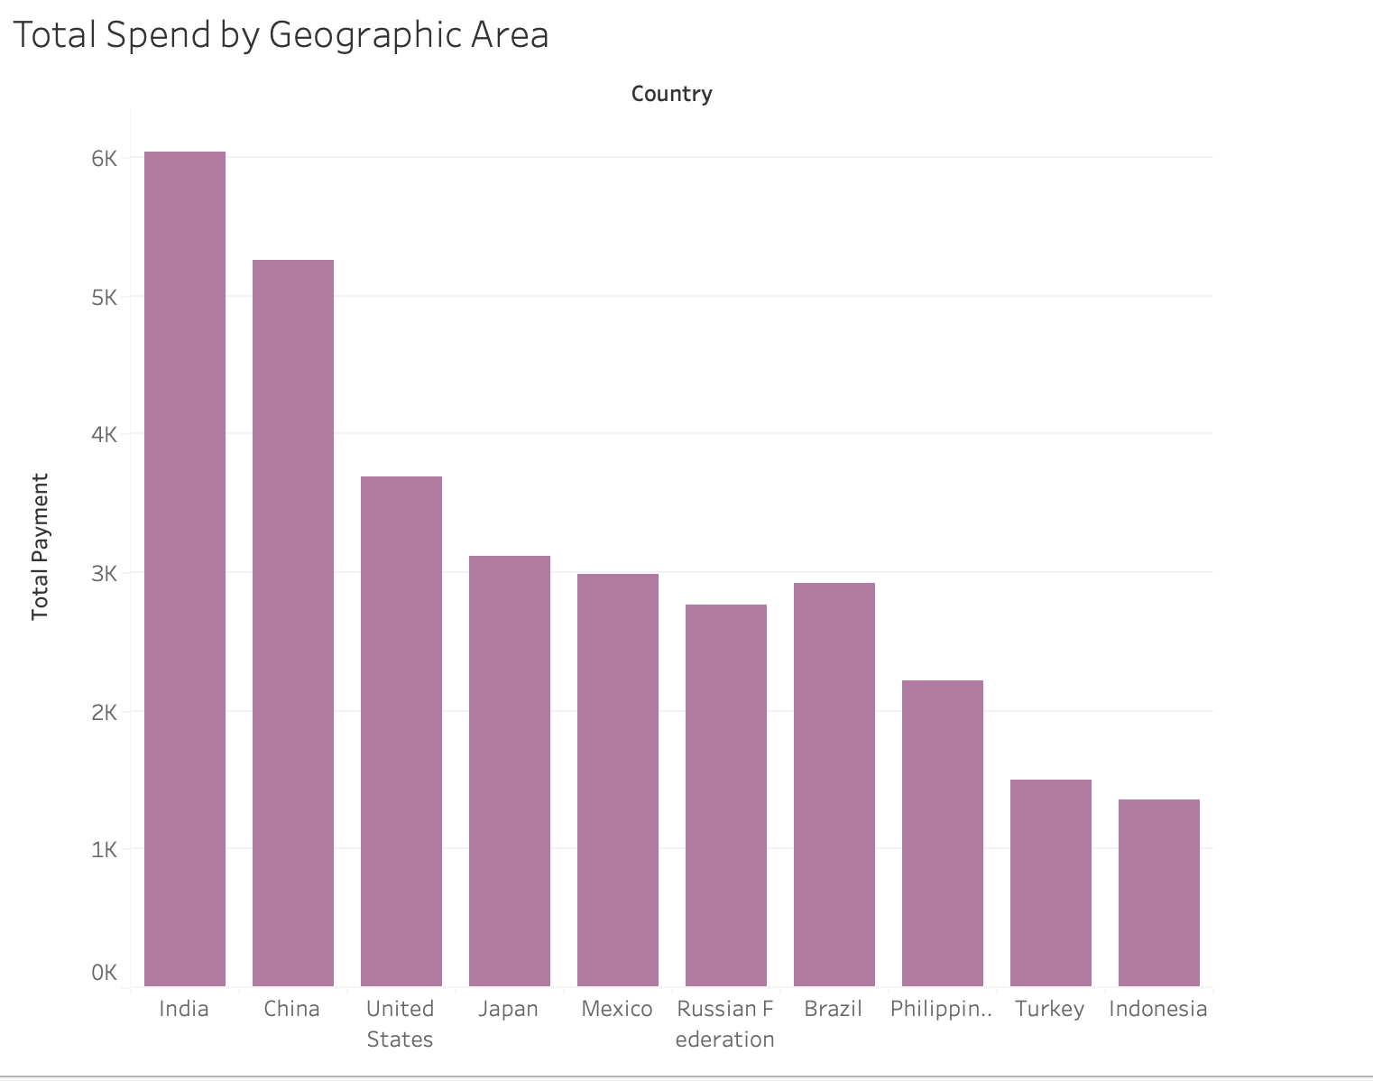
Key MARKETS by spend and COUNTRY
India has the highest spend at $6,000
The spending range for the top 10 countries is between $1,353 and $6,000

Slide 9
Key Markets: TOP 10 cities
Country | City | Customers
United States | Aurora | 2
Mexico | Acua | 1
United States | Citrus Heights | 1
Japan | Iwaki | 1
India | Ambattur | 1
China | Shanwei | 1
Brazil | So Leopoldo | 1
Russian Federation | Teboksary | 1
China | Tianjin | 1
Indonesia | Cianjur | 1
Three (3) of the top 10 cities where customers are based are in the United States and two (2) are in China

Slide 10
TOP genres in top 10 cities
City | Genre
Acua | Drama
Ambattur | Sci-Fi
Aurora | Children
Cianjur | Animation
Citrus Heights | Action
Iwaki | New
Shanwei | Drama
So Leopoldo | Animation
Teboksary | Music
Tianjin | Games
Drama and Animation Genres are 2 of the most popular genres across countries

Slide 11
ROCKBUSTERS TOP SPENDERS
First Name | Last Name | City | Country | Total Amount Paid
Arlene | Harvey | Ambattur | India | $ 111.76
Kyle | Spurlock | Shanwei | China | $ 109.71
Marlene | Welch | Iwaki | Japan | $ 106.77
Glen | Talbert | Acua | Mexico | $ 100.77
Clinton | Buford | Aurora | United States | $ 98.76
Arlene Harvey from Ambattur, India is the top spender
The average spend of the top 5 payers is $105

Slide 12


Insights & Recommendations
Focus building brand in these countries: India, China, U.S., Japan, Mexico, Russia, Brazil, Philippines, Turkey, Indonesia
Top 10 countries based on customers also match top 10 countries based on spend
50% of top cities based on customer volume and spend are in U.S. and China
Investigate further customer behaviors in Aurora, Citrus Heights (U.S.) and Shanwei, Tianjin (China)

Slide 13


Insights & Recommendations
Each top city has a genre that is popular with customers. This is what customers want to see.
Execute brand awareness strategy in a culturally relevant way using genre as the driver. For instance, Drama is the top genre in Acua, Mexico.
Top 5 Spenders can provide valuable insights into customer behavior and brand recognition testing
Conduct a focus group with these top 5 spenders while also rewarding them for their loyalty!

